Slide 1
DATA WAREHOUSING
By
Syed Bakhtawar Shah Abid
Assistant Professor
Department of Computer Science
Data Warehousing

Slide 2
The Dynamic, Ad hoc report
A report that can be quickly modified by its user to present either greater or lesser detail without any additional programming required.
A decision maker should be able to start with a short report that summarizes the performance of the enterprise.
The decision maker then point to the portion of report that bears closer inspecting for getting more detail.
Data Warehousing

Slide 3

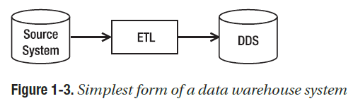
Components of a Data Warehouse
Data Warehousing

Slide 4
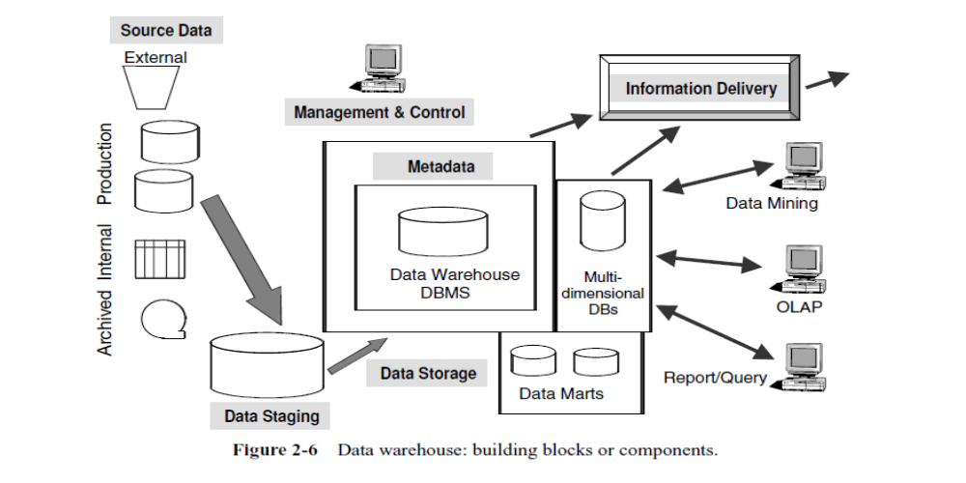
Components of a Data Warehouse
Data Warehousing

Slide 5
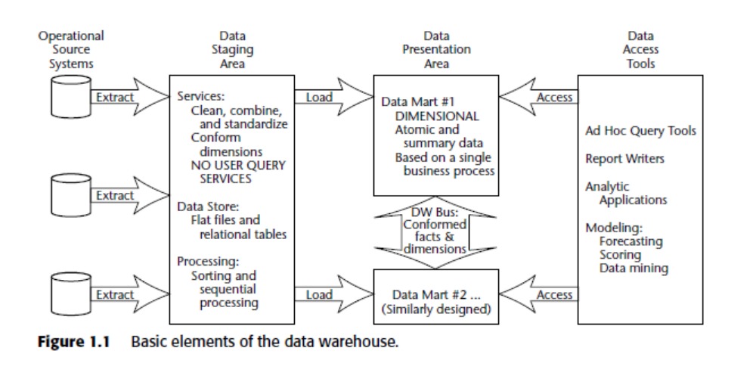
Basic Elements of a Data Warehouse
Data Warehousing

Slide 6
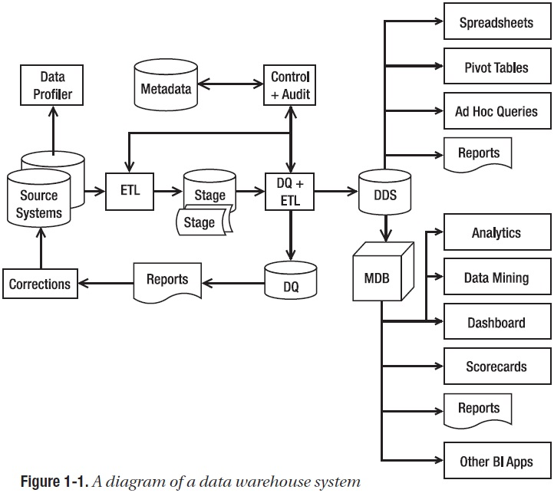
Data Warehouse System
Data Warehousing

Slide 7
Components of a Data Warehouse
Source Data Component
  Production Data
  Internal Data
  Archived Data
  External Data
Data Staging Component
  Data Extraction
  Data Transformation
  Data Loading
Data Storage Component
Information Delivery Component
Metadata Component
Management and Control Component
Data Warehousing

Slide 8
Data profiling
Data profiling is the process of examining the data available in an existing information data source (e.g. a database or a file) and collecting statistics and small but informative summaries about that data.
The purpose of these statistics may be to:
  Find out whether existing data can easily be used for other purposes
  Improve the ability to search the data by tagging it with keywords, descriptions, or assigning it to a category
  Give metrics on data quality including whether the data conforms to particular standards or patterns
  Assess the risk involved in integrating data for new applications, including the challenges of joins
Data Warehousing

Slide 9
DATA PROFILER
A data profiler is a tool that has the capability to analyze data, such as finding out how many rows are in each table, how many rows contain NULL values, and so on.
Data Warehousing

Slide 10
EXTRACT, TRANSFORM, AND LOAD (ETL)
ETL system
  Brings data from various source systems into a staging area.
  It has the capability to
    Connect to the source systems
    Read the data
    Transform the data, and
    Load it into a target system
  The ETL system then integrates, transforms, and loads the data into a dimensional data store (DDS).
Data Warehousing

Slide 11
EXTRACT, LOAD, AND TRANSFORM
(ELT)
An alternative approach to ETL is ELT.
In this approach, the data is loaded into the data warehouse first in its raw format.
The transformations, lookups, deduplications, and so on, are performed inside the data warehouse.
Unlike the ETL approach, the ELT approach does not need an ETL server.
This approach is usually implemented to take advantage of powerful DW database engines such as massively parallel processing (MPP) systems.
Data Warehousing

Slide 12
DIMENSIONAL DATA STORE (DDS)
A DDS is a database that stores the data warehouse data in a different format than OLTP.
The reasons for getting the data from the source system into the DDS and then querying the DDS instead of querying the source system directly is that
  In a DDS the data is arranged in a dimensional format that is more suitable for analysis.
  A DDS contains integrated data from several source systems.
Data Warehousing

Slide 13
DIMENSIONAL DATA STORE (DDS)
A DDS is one or several databases containing a collection of dimensional data marts.
A dimensional data mart is a group of related fact tables and their corresponding dimension tables containing the measurements of business events categorized by their dimensions.
A dimensional data store is denormalized dimension table
Data Warehousing

Slide 14
Normalized Data Store (NDS)
A NORMALIZED DATA STORE is one or more relational databases with little or no data redundancy.
A relational database is a database that consists of entity tables with parent child relationships between them.
An NDS is usually in third normal form or higher, such as fourth or fifth normal form.
Data Warehousing

Slide 15
DATA QUALITY (DQ)
When the ETL system loads the data into the DDS,
  The data quality rules do various data quality checks.
  Bad data is put into the data quality (DQ) database to be reported and then corrected in the source systems.
  Bad data can also be automatically corrected or tolerated if it is within a certain limit.
Data Warehousing

Slide 16
METADATA
The metadata is a database containing information about
  The data structure,
  The data meaning,
  The data usage,
  The data quality rules, and
  Other information about the data.
Data Warehousing

Slide 17
AUDIT SYSTEM
The audit system logs the system operations and usage into the metadata database.
The audit system is part of the ETL system that monitors the operational activities of the ETL processes and logs their operational statistics.
It is used for understanding what happened during the ETL process.
Data Warehousing

Slide 18
FRONT-END TOOLS
Users use various front-end tools such as
  Spreadsheets
  Pivot tables
  Reporting tools, and
  SQL query tools to retrieve and analyze the data in a DDS.
Data Warehousing

Slide 19
MULTIDIMENSIONAL DATABASES (MDBs)
Some applications operate on a multidimensional database format.
For these applications, the data in the DDS is loaded into MDBs,
  MDBs are also known as cubes.
An MDB is a form of database where the data is stored in cells and the position of each cell is defined by a number of variables called dimensions.
Each cell represents a business event, and the values of the dimensions show when and where this event happened.
Data Warehousing

Slide 20
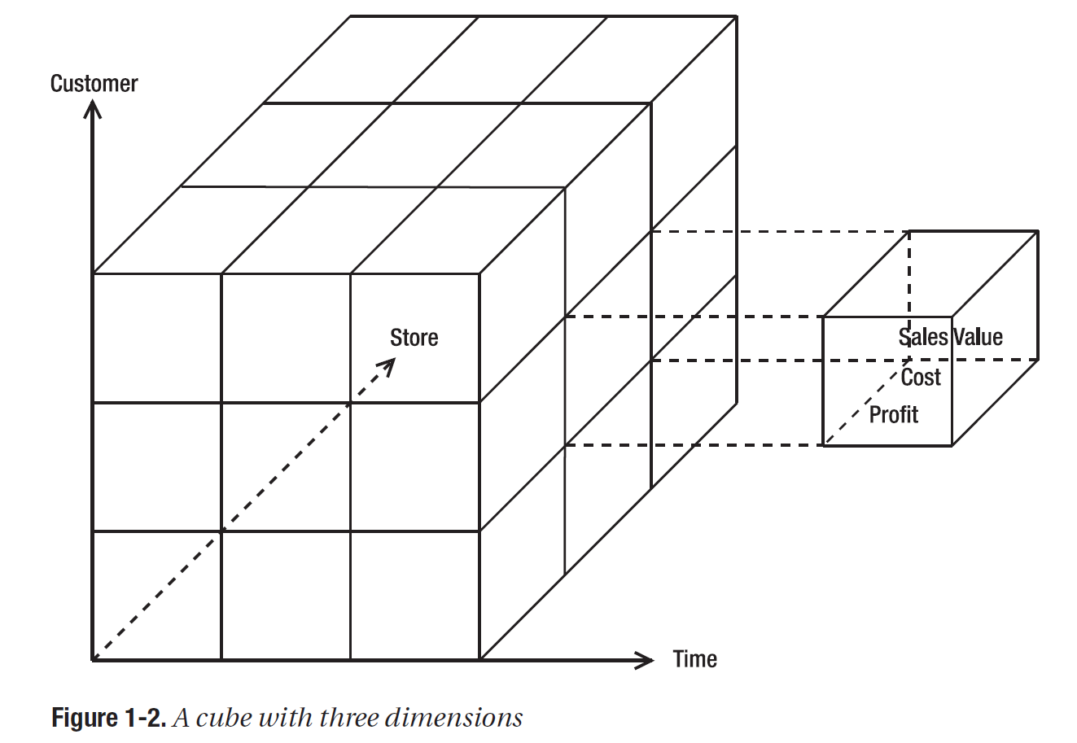
CUBE
Data Warehousing

Slide 21
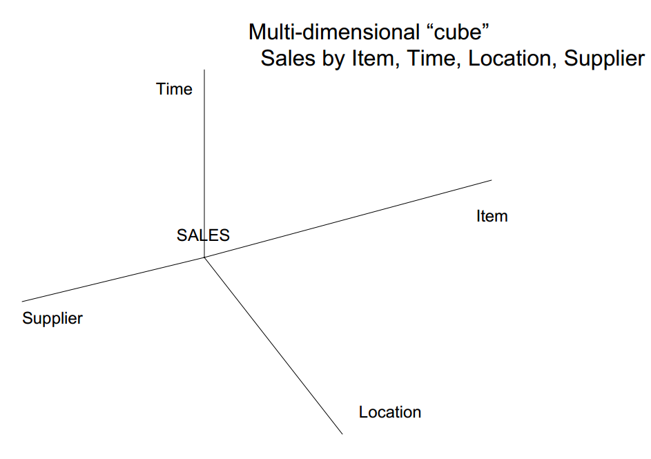
CUBE
Data Warehousing

Slide 22
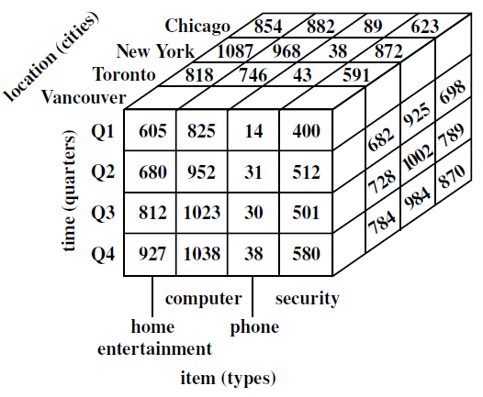
CUBE
Data Warehousing

Slide 23
OPERATIONAL DATA STORES
OPERATIONAL DATA STORE is defined as
  “The architectural construct where collective integrated operational data is stored.”
  “A collection of integrated databases designed to support operational monitoring
  Unlike the databases of OLTP applications (that are operational or function oriented), the ODS contains subject oriented, enterprise wide data.
  Unlike DW, the data in the ODS are volatile, current and detailed.
Data Warehousing

Slide 24
OPERATIONAL DATA STORES
The ODS provides an integrated view of the data in the operational systems.
Data are transformed and integrated into consistence, unified whole as they obtained from legacy and other operational systems to provide business users with an integrated and current view of the operations.
Data in the ODS are constantly refreshed so that the resulting image reflects the latest state of operations
Data Warehousing

Slide 25
Challenges of the ODS
Location of the appropriate sources of data
Transformation of the source data to satisfy the ODS data model requirements
A DBMS that combines effective query processing with transactional processing capabilities that ensures ACID transaction properties.
Data Warehousing

Slide 26
OPERATIONAL DATA STORES vs DW
Although both technologies support decisional information need of enterprise decision-makers, the two are distinctly different and are deployed to meet different types of decisional information needs.
Data Warehousing

Slide 27
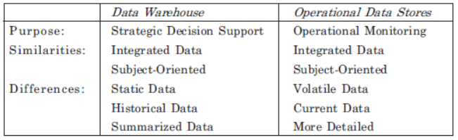
OPERATIONAL DATA STORES vs DW
Data Warehousing

